Slide 1

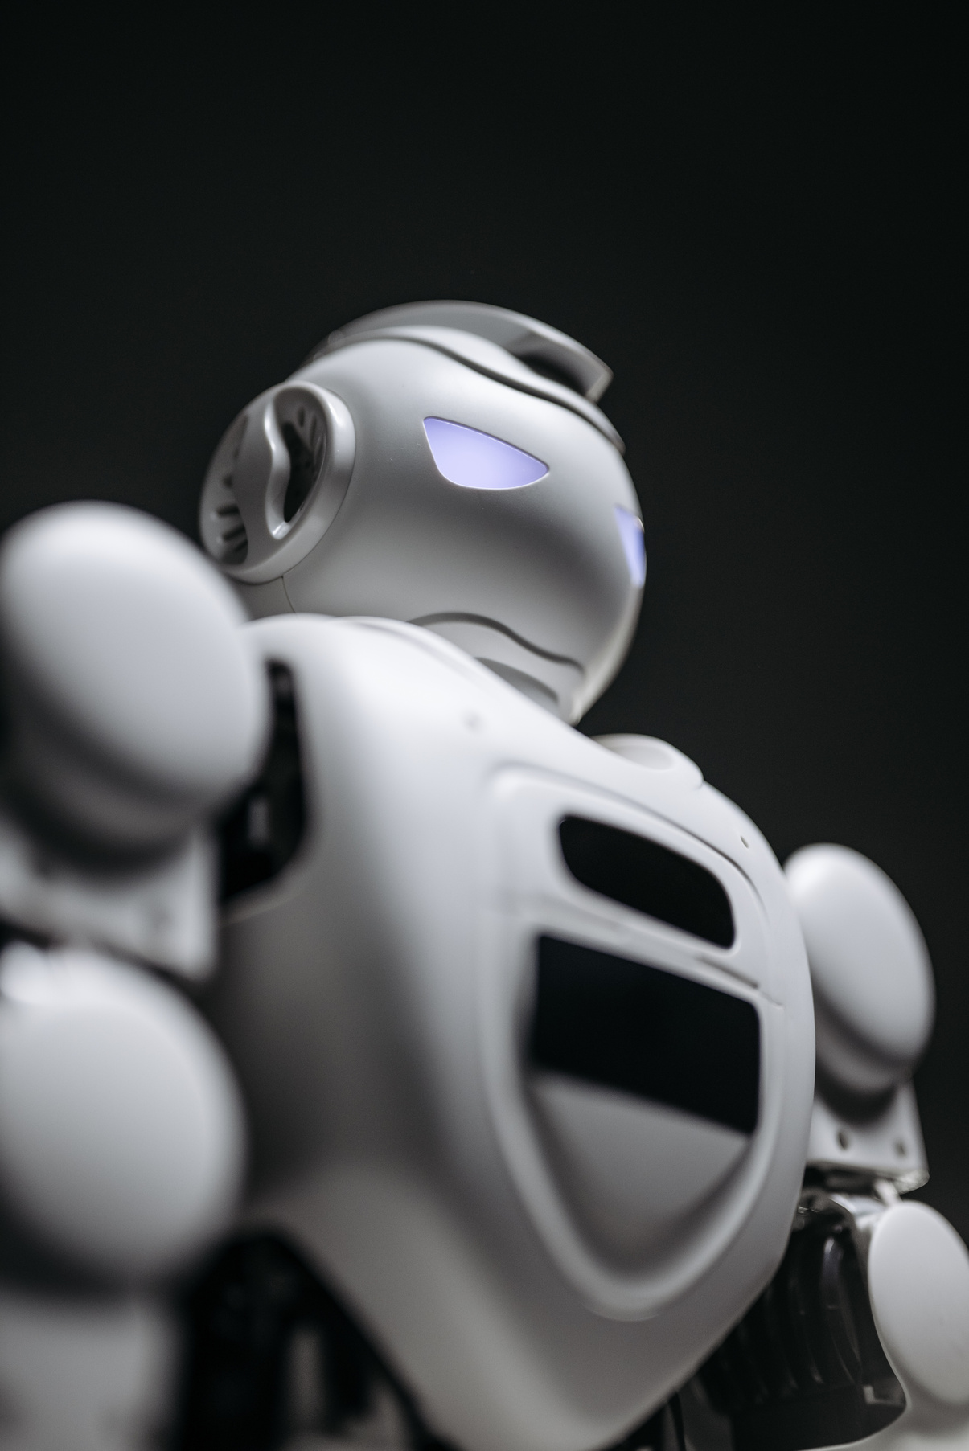
BTech 6th Semester Mini Project
Obstacle
Avoiding
Bot
By Dyuti Ghosh, Soutrik Acharya, Ratul Chakraborty, Sayan Nandi and Sudeshna Pahari

Slide 2
What is an obstacle avoidance bot?
Sensors
In this Presentation
Ultrasonic Sensors
Algorithm, Components, Schematic
Here's what we'll cover:
Practical Demonstration
Observation
Applications

Slide 3
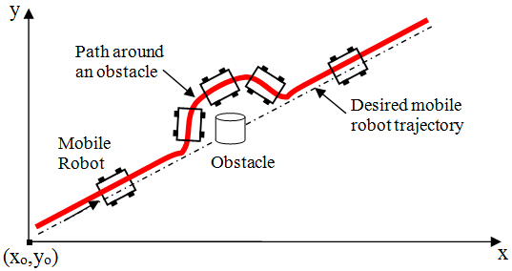
What is an obstacle avoidance robot?
Obstacle Avoidance is a means of a robot being able to move around in an unknown environment without colliding withsurrounding objects.
(The figure represents a diagramatic representation of the same)

Slide 4
Introduction to Sensors
A sensor is a device that detects and responds to some type of input from
the physical environment.
The specific input could be light, heat, motion, moisture, pressure.
The output is generally a signal that is converted to human-readable form

Slide 5
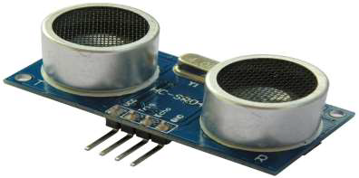
Introduction to Ultrasonic Sensors
The sound beyond human hearing range ( 20,000 Hz ) is known as
ultrasonic.
Ultrasonic sensors are sensors that convert ultrasound waves
to electrical signals or vice versa.

Slide 6
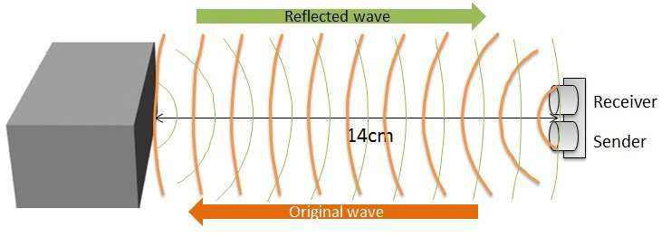
How does an Ultrasonic Sensor work?
2 parts of an Ultrasonic Sensor
are:
They emit sound waves and receive back reflected waves.
A transmitter that sends out a signal that humans cannot hear
The time it takes to receive the waves back provides them with a very good estimate of the distance.
A receiver that receives the signal after it has bounced off nearby objects
The sensor sends out its signal and determines how long the signal takes to come back.

Slide 7


HC-SR04
The distance has been calculated using
Distance = ½ T x C
(T = Time,
C = the speed of sound=342m/s)
The sensor gives readings of T in µs.
Therefore,
Distance (in cm) = ½ T x 0.0342
While moving forward, if this distance is found to be less than a minimum value, then the car is quickly stopped and reversed.

Slide 8
1
ARDUINO UNO
Components
used
ULTRASONIC SENSOR HC-SR04
2
3
MOTOR DRIVER L298N
4
2 DC MOTOR WITH WHEELS
We have used 2 non-rechargable batteries. One to power the arduino and hence the ultrasonic sensor. The other was to power the motor driver and hence the motors.
5
9V BATTERIES

Slide 9
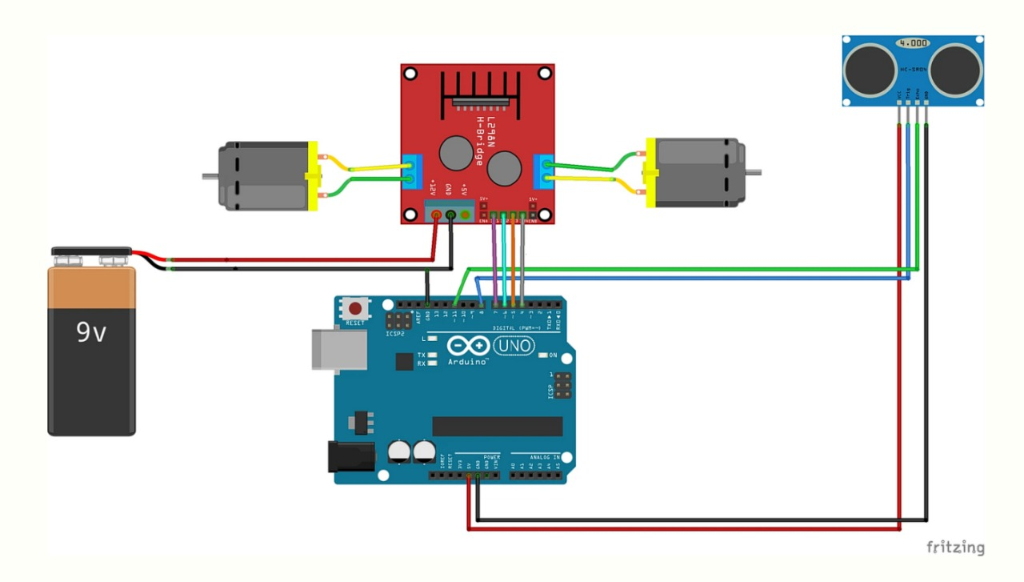
The Schematic

Slide 10
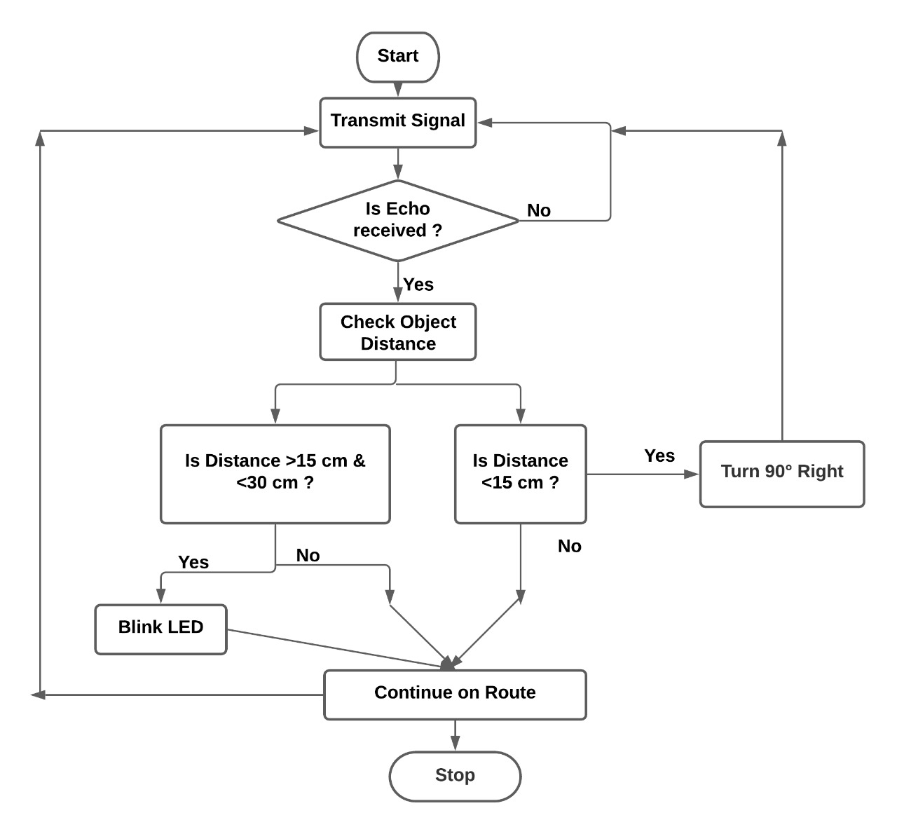
The Algorithm
for the Obstacle Avoidance Bot

Slide 11

The bot drives through freely and moves forward if there are no obstacles in front.

Slide 12
When obstacle is detected within
30cm to 15cm
it will blink the LED.

Slide 13
When the obstacle is less than 15cm it will stop. Takes reverse. And then turns right.

Slide 14



OBSERVATIONS

Slide 15



Without Obstacle!
This was the observation when there were no obstacle in the bot's way!
Distance
Time
Speed
100 cm (fixed)
12.15 seconds (observed)
8.23 cm/second (calculated)

Slide 16
With Obstacle!
Now, the distance was kept fixed at 100 cm.
Then the obstacles were placed in different
location in its path.
The time taken to cover the 100 cm was recorded.
The speed is then calculated.
This was then repeated by increasing the number
of obstacles as 1, 2, 3, 4, and 5.
Thus 5 such records were noted for each of the 5 cases.

Slide 17
With Obstacle - CASE 1
No of obstacles = 1
Distance of obstacle from starting point = 50 cm
Distance
Time
Speed
100 cm (fixed)
14.55 seconds (observed)
6.87 cm / second (calculated)

Slide 18
With Obstacle - CASE 2
No of obstacles = 2
Distance from starting point for
Obstacle 1 => 30 cm II Obstacle 2 => 60 cm
Distance
Time
Speed
100 cm (fixed)
17.05 seconds (observed)
5.87 cm / second (calculated)

Slide 19
With Obstacle - CASE 3
No of obstacles = 3
Distance from starting point for
Obstacle 1 => 25 cm II Obstacle 2 => 50 cm II Obstacle 3 => 75 cm
Distance
Time
Speed
100 cm (fixed)
20.45 seconds (observed)
4.89 cm / second (calculated)

Slide 20
With Obstacle - CASE 4
No of obstacles = 4
Distance from starting point for
Obstacle 1 => 20 cm II Obstacle 2 => 40 cm
Obstacle 3 => 60 cm II Obstacle 4 => 80 cm
Distance
Time
Speed
100 cm (fixed)
23.85 seconds (observed)
4.19 cm / second (calculated)

Slide 21
With Obstacle - CASE 5
No of obstacles = 5
Distance from starting point for
Obstacle 1 => 10 cm II Obstacle 2 => 30 cm
Obstacle 3 => 50 cm II Obstacle 4 => 70 cm II Obstacle 5 => 90 cm
Distance
Time
Speed
100 cm (fixed)
28.25 seconds (observed)
3.54 cm / second (calculated)

Slide 22
Note.
With each case of increasing obstacles,
The time taken to cover same distance has increased.
The speed has thus decreased.

Slide 23
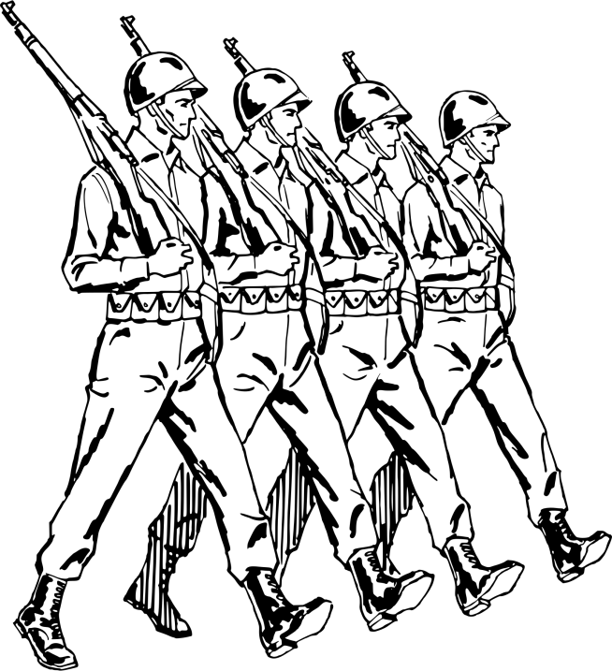


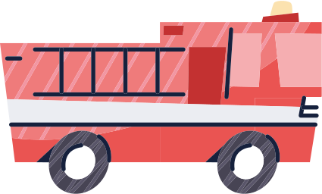
APPLICATIONS
There are various applications. The exposure to hazards are mitigated to the person who operate the vehicle from a location of relative safety.
Deep
Oceans
Military
Engagements
Space
Explorations
Fire Exinguisher Car

Slide 24

Team
Dyuti Ghosh
T91/ECE/184062
Soutrik Acharya
T91/ECE/184065
Ratul Chakraborty
T91/ECE/186012
Sayan Nandi
T91/ECE/186006
Sudeshna Pahari
T91/ECE/186015
ANY QUESTIONS?

